Slide 1
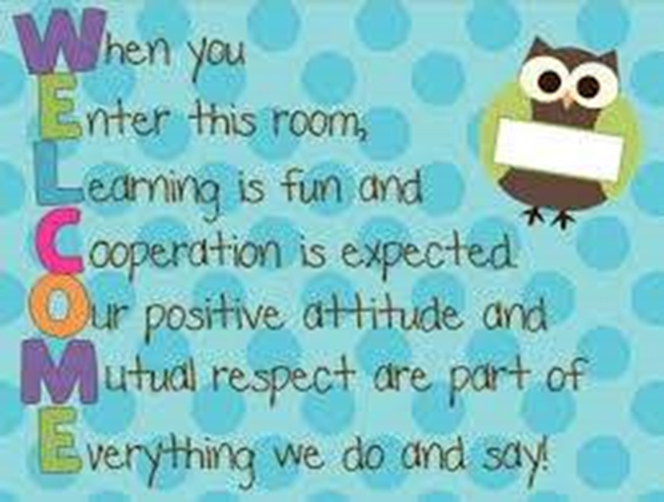
Notes:
When you
Enter this room,
Learning is fun and
Cooperation is expected
Our positive attitude and
Mutual respect are part of
Everything we do and say!

Slide 2
How to identify an unhealthy Auxiliary
Fall Conference – St. Cloud, Minnesota
September 26, 2020
Jane Ziebarth, Chief of Staff
Notes:
Fall Conference – St. Cloud, Minnesota
September 26, 2020
Jane Ziebarth, Chief of Staff
How to identify an unhealthy Auxiliary.
Today we are going to visit problem areas followed with some positive helpful hints.

Slide 3
What constitutes an unhealthy Auxiliary?
100 percent in membership?
Timely reporting?
All officers and chairmen positions filled?
Officers (and members) in possession of current Bylaws and Ritual?
No personality conflicts?
All obligations fulfilled?
Notes:
What constitutes an unhealthy Auxiliary?
100 percent in membership?
Timely reporting?
All officers and chairmen positions filled?
Officers (and members) in possession of current Bylaws and Ritual?
No personality conflicts?
All obligations fulfilled?
Wouldn’t it be wonderful if that indeed were the signs for an unhealthy Auxiliary. If that was the case, we wouldn’t be having this discussion today.

Slide 4

Notes:
A healthy attitude is contagious but don’t wait to catch it from others…..be a carrier.
Is your attitude worth catching?

Slide 5

Underline signs of concern?
Aging members
Constraints of attending meetings
Lack of participation
Repeat officers’ year-after-year
Notes:
Underline signs of concern?
With the aging membership, constraints of attending meetings, lack of participation, and repeat of officers’ year-after-year, it doesn’t always mean an Auxiliary is unhealthy but could be signs of underline concerns.

Slide 6
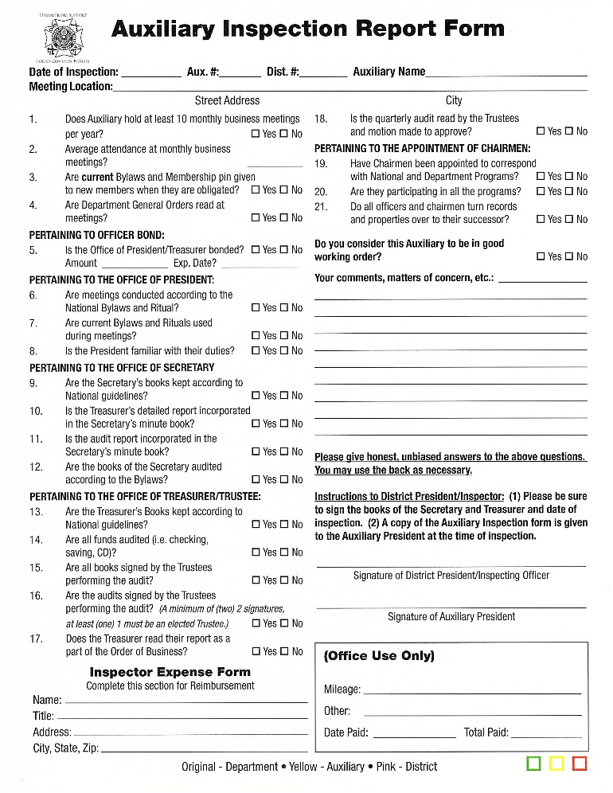
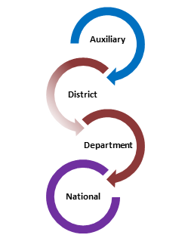
Ways to detect an unhealthy Auxiliary
Annual visit
Auxiliary Membership Communication
Notes:
Ways to detect an unhealthy Auxiliary
ANNUAL VISIT
One significant way of detecting an unhealthy Auxiliary is through the annual visits by the District President and/or his/her representative. This individual being honest on their report form and alerting the Department President of any concerns provides a focus on assigning assistance and tools to remedy the concern.
AUXILIARY MEMBERSHIP COMMUNICATION
Another valuable way of detecting an unhealthy Auxiliary is through that Auxiliary’s membership and their communication to District and Department Leadership. There is no shame in asking for assistance or expressing concerns. This is a positive approach. By bringing to surface, an issue so it may be addressed before it festers into a full-blown problem is an attempt to become healthy again. This can ward off the negative impact that could take place if not handled.

Slide 7
What are signs that an Auxiliary may be entering an unhealthy state of mind?
Notes:
What are signs that an Auxiliary may be entering an unhealthy state of mind?

Slide 8

Lack of ability to elect officers
Is there a lack of understanding of responsibilities?
Are members getting tired of holding office?
Not enough participation to fulfill positions?
Notes:
Lack of ability to elect of officers
Is there a lack of understanding of responsibilities?
Review Bylaws, Booklet of Instructions and Building on the VFW Auxiliary Foundation for guidance
Are members getting tired of holding office?
Offer to mentor the individual who may be willing to take on responsibility
Don’t disappear….fulfill your obligation to assist those that go after you.
Continue to serve with receiving and accepting assistance from others
Not enough participation to fulfill positions?
No member shall hold two elective offices on the same level at the same time.
The member may hold one elective and one or more appointive offices on that level.
The exception to this rule being that a Trustee may hold another elective or appointive office other than President, Secretary or Treasurer. (Sec. 801 – Eligibility)
Nominating committees shall be permitted for Auxiliaries. (Sec. 804A – Auxiliary)
Educate
Support and mentor
We’re all in this together! You’re a vital piece of the puzzle!

Slide 9
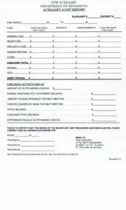


Quarterly audit reports not completed and submitted by due date
Books of Secretary and Treasurer not being available
Treasurer does audit
Trustees signing report without reviewing books
Notes:
Quarterly audit reports not completed and submitted by due date
Books of Secretary and Treasurer not being available
Set up time for all to meet to assure all books are available
Engage a pro-tem trustee if not all are available
Consider doing prior to regular business meeting
Treasurer does audit
Do not sign audit report unless process is completed by Trustees
Trustees signing report without reviewing books
Review responsibilities of the Trustees in Sec. 814 – Trustees, Duties of (All levels)
A trustee is a vital position to maintaining a healthy Auxiliary.
Request guidance if unsure of process or concerns

Slide 10

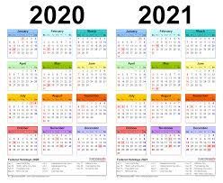
Unable to obtain a quorum for business meeting
It only takes 5
Must hold at least 10 business meetings
Notes:
Unable to obtain a quorum for business meeting
It only takes 5
Utilize media resources, zoom, conference call, etc. Video conferencing or teleconferencing is permitted for members unable to attend the meeting provided a quorum is present at the meeting site.
Evaluate day, time, location
Must hold at least 10 business meetings
Evaluate day, time, location
For planning purposes, the Auxiliary may predetermine which two months a meeting may not be held, or reserve that option for inclement weather.

Slide 11


Outdated Bylaws and Ritual and/or
Standing Rules
Each year an updated National Bylaws, Booklet of Instructions, and Ritual Book is produced
Standing Rules not being reviewed and updated yearly may become outdated with invalid information
Notes:
Outdated Bylaws and Ritual and/or Standing Rules
Each year an updated National Bylaws, Booklet of Instructions, and Ritual book is produced.
Every Auxiliary should have in their possession a current edition.
The current edition is available for purchase by all members in good standing.
Standing rules not being reviewed and updated yearly may become outdates with invalid information.
Best practice should be to review yearly.

Slide 12
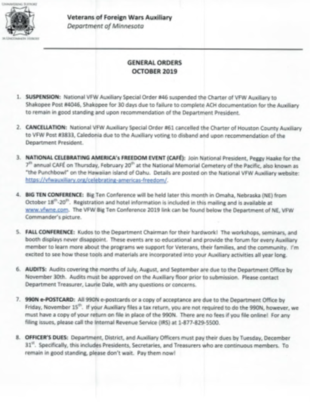
Referencing Outdated Materials
General orders, chairmen bulletins, etc.
Destroy old forms
Notes:
Referencing outdated materials (general orders, chairmen bulletins, etc.)
Destroy old forms
By not doing so, wrong information could be shared.
Timelines not met.
Inaccurate and incomplete forms.
Misunderstanding of information.
With the new program year comes new general orders, bulletins, forms.

Slide 13
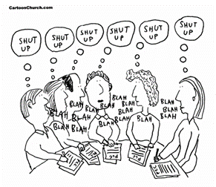
Personal Conflict
Disregard for another person’s opinion
Bullying
Closed minds
Notes:
Personal conflict
Disregard for another person’s opinion
Bullying
Closed minds
There is no room for petty jealousies
Every member deserves respect
Value each member’s contribution
We are not all going to agree all the time…that’s okay…but disagree in a respective manner
Stay off social media with your personal views of another member or Auxiliary business
Embrace the mentoring program and ideals to help diminish personal conflict
Most of all remember why you joined the organization

Slide 14


Usage of Demeter's Manual of Procedures
Roberts Rules of Order, Newly Revised replaced Demeter's.
Notes:
Usage of Demeter’s Manual of Procedures
Roberts Rules of Order, Newly Revised replaced Demeter's and shall govern on all points not covered in the Bylaws. (Sec. 916 – Rules of Order)

Slide 15
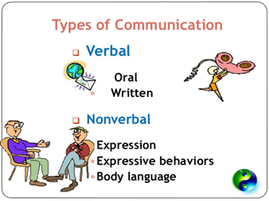
Lack of Communication
Select few are privileged to information
Leave no member behind
Every member has a right to learn, participate, be respected and rewarded
Notes:
Lack of Communication
Select few are privileged to information
All members should be aware of activities and business decisions of the Auxiliary
Final decisions should not be made outside the meeting room between a few cliché members
Leave no member behind
All members should be made aware of meeting dates, activities, volunteer opportunities
Create a monthly or quarterly communication whether written or verbal (call tree)
Obtain Auxiliary Facebook and or web page
Gather email addresses to remain in contact
Every member has a right to learn, participate, be respected and rewarded.
Make the most out of having a mentoring program and/or designated mentor
Types of communication
Verbal
Oral
Written
Nonverbal
Expression
Expressive behaviors
Body language
All types of communication should be set in a positive tone

Slide 16

Dissention between Auxiliary and Post
Is it because of lack of communication
Lack of respect
Personality conflict
Notes:
Dissention between Auxiliary and Post
Is it because of lack of communication
Lack of respect
Personality conflict
If it weren’t for the Post….we wouldn’t be here
Set personalities aside and work towards our common goal…serving veterans, their families and the community
Respect the person who wore the uniform granting our freedom
Find common ground
Don’t meddle in Post business…..focus on Auxiliary business
Build trust between the Post and Auxiliary
Engage in joint project
Offer or request assistance for a positive outcome and experience
LET’S WORK TOGETHER!

Slide 17
Non-Compliant
Not meeting IRS filing requirements
Not meeting District and Department Obligations
Reminder….these tasks happen every year!
IRS Form 990-N EPOSTCARDS
DISTRICT DUES
ELECT, INSTALL AND REPORT OFFICERS
UP TO DATE AUDITS
10 MONTHLY BUSINESS MEETINGS
DUES PAID ON 10 MEMBERS BEOFRE FEBRUARY 1
PRESIDENT & TREASURER BOND
Notes:
Non-compliant
Not following Bylaws
Department Secretary/Treasurer Laurie touched on the importance of the Bylaws
Review a section of the Bylaws at each meeting
Consider having a member chose a topic of interest
Not meeting IRS filing requirements
If you need assistance contact the Department Treasurer
Not meeting District and Department obligations
Include these obligations in your standing rules
Reminder…these tasks happen every year.

Slide 18

Misuse of funds
Expending money without having passed a motion
Unaccounted cash receipts and disbursements
Funds belong to Auxiliary - not an individual
Notes:
Misuse of funds
Expending money without having passed a motion
Trustees should be reviewing expenditures when processing audit to assure proper authority was followed when funds were dispersed
Unaccounted cash receipts and disbursements
Receipts for both should be on file
Trustees should be comparing Secretary minutes and Treasurers report regarding expenditures
Special project funds
Make sure to have checks and balances in place
Funds belong to the Auxiliary – not an individual

Slide 19


Performance of duties
Officers and Chairmen are not performing duties as required
Notes:
Performance of duties
Officers and Chairmen are not performing duties as required
Is it a lack of interest or understanding the roles and responsibilities
Utilize the Building on the VFW Auxiliary Foundation Guidebooks
Revisit the Bylaws for position descriptions
Is it having too many responsibilities

Slide 20
Declining Membership
No interest to increase or maintain membership
Reduction in membership with no attempt to recruit new and reinstate members
Timely dues remittance
Not contacting members
Members not valued, thanked or praised for the work they do
Members feel useless or frustrated
Members feel they are getting nothing out of belonging
Notes:
Declining Membership
No interest to increase or maintain membership
Reduction in membership with no attempt to recruit new and reinstate members
WHY - - - WHY NOT reach out?
Review the membership wheel for eligibility
Use community resources to get the message out about the Auxiliary
Review and disseminate brochures available from the Resource page
Revisit family member eligibility
Ask….ask the question to familiar and unfamiliar individuals
Timely dues remittance
Utilize MALTA to transmit dues
Processing membership dues should not be held
Employ MALTA to generate membership dues reminders
Not contacting members
Sure way of eliminating volunteers, active members and valuable leaders
Members not valued, thanked or praised for the work they do
Find ways to positively recognize members for their contributions inside and outside the meeting room
Thank you note
Volunteer recognition event
Certificate recognizing member’s contribute – successful program
Members feel useless or frustrated
Encourage members to get involved in projects
Don’t wait for a member to volunteer …ASK if they would participate
Members feel they are getting nothing out of belonging (of the organization)
Give members responsibilities and tasks; team them up with experienced members.
Turn the table…identify the positive achievements due to their membership and value they bring
Supporting the veterans, family, communities

Slide 21
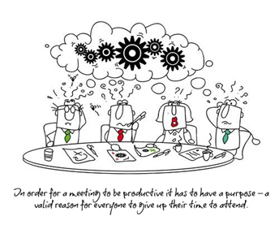
Meetings are a waste of time
Long and boring
No discussion
No action
Lack of participation
Notes:
In order for a meeting to be productive, it has to have a purpose – a valid reason for everyone to give up their time to attend.
Meetings are waste of time
Long and boring
Don’t have meetings just to meet
Have an agenda and purpose
Provide a clear direction
No discussion
Select few make decisions for the group outside the meeting room
Discussion is healthy but decisions are to be made by the body of the organization
Allow open dialogue where all opinions matter
Value the voice of the member
Discussion is healthy and necessary to understand the topic or action
No action
Create a positive atmosphere, ask questions and don’t discount another’s view or motion
Be the solution, not the problem
Every meeting should have some type of action needed. Approve bills, approve and/or plan a project, you get the picture.
Lack of participation
Members do little other than listen to leaders talk
A select group of individuals have all the power
Lack of encouragement for others to get involved
Structure meetings so they produce energy.
Allow everyone to have a chance to participate – not just a selective group.
In order for a meeting to be productive it has to have a purpose – a valid reason for everyone to give up their time to attend.

Slide 22

Lack of interest in Programs
Chairmen not appointed
Bulletins not shared
Thoughts that there are no projects members can be involved in
Year-end reports
Notes:
Lack of interest in Programs
Chairmen not appointed
Seek volunteers or “ask” someone to chair
Identify a chairman’s responsibility
Monthly report
Instrumental in promoting and participating in project
Complete year-end report
Bulletins not shared
Ask President and/or Secretary to share and/or review during meeting
Subscribe to receive General Orders and bulletins via email (free)
Request paper copy of General Orders and bulletins for a fee of $35
Visit Department website where General Orders and bulletins are posted
Take the initiative on your own to find out what is happening.
Thoughts that there are no projects members can be involved in.
The Auxiliary provides a variety of interests through its programs
Provide a description of each program…find your members passion that fits in to a program
Utilize the materials provided by Department and National, especially the Resource page within Malta
With limited resources (funds, volunteers, etc.) address/plan for one project a month
Year-end reports
No participation
Every program should be able to come up with at least one item/activity to report
Plan for year-end reports throughout the year
Review Department and National Program books for information that will be requested

Slide 23
Don’t think inside or outside the box…..
ELIMINATE THE BOX!
Notes:
Don’t think inside or outside the box….ELIMINATE THE BOX!

Slide 24

FAILURE IS NOT AN OPTION!
Auxiliary Healthy Toolkit
Online Academy
MALTA – Resource Page
National Programs BLOG
Facebook
Department Website
Notes:
You only fail when you stop trying!
Failure is not an option!
The tools are available within the Auxiliary Healthy Toolkit
Auxiliary Meeting Checklist
Healthy Communication Phone-Text Tree
RU Healthy Checklist – To Do’s and Deadlines
VFW Auxiliary Meeting Challenges and Solutions
VFW Auxiliary Member Questionnaire
VFW Auxiliary Sample Meeting Agenda
Online Academy
MALTA – Resource Page
Various promotional materials and forms
National Program book
National Programs BLOG
Facebook
Department Website
District and Department Leadership and Chairmen
Mentors!

Slide 25

Can my Auxiliary be healthy?
Notes:
Can my Auxiliary be healthy?
You know what….yes you can!

Slide 26
Positive questions are more likely to generate…
Positive energy that leads to…
People achieving positive results!
Notes:
Positive questions are more likely to generate….
Positive energy that leads to….
People achieving positive results!

